Slide 1
Social Space for Smart Farming
SMART AGRI HUB
Petr Uhlir, Marek Splichal, Michal Kepka, Andrei Grishanov, Ratis Berzins, Raul Palma, Ilze Bargā, Karel Charvat, Jiri Kvapil, Dmitrij Kozuch

Slide 2
Our goals
The goal is to design and developed prototype of Agriculture Innovative Hub, which will integrate on one side principles of social media like Blog, Forum, design Science Shop, which will be able to connect users with developers and researchers and also integrate different types of demo application, where farmers developers, researchers will have chance to cooperate, test different API for new solution and also provide common experiment. Solution will be based on utilization of Liferay Portal and as backend will use SQL and non SQL database and will integrate tools like SensLog, HSlayers NG etc.
Knowledge and information basement
Farms, agro and technological companies presentation place
Become a community portal

Slide 3
Initial analysis
Target groups
- farmers, forest management, scientists, developers, …
- system developers – for UX and testing
Keywords analysis – searchability/number of competitors/relevancy
- information architecture
- content
- SEM (Search Engine Marketing)
- SEO (Search Engine Optimization)
Analysis of competitors
Business analysis and monetarisation
KPI – Key performance indicators

Slide 4
Basic functionality
Interested content – blog miniseries
- news
- technology / processes
- problem solving
- how to, etc.
Webinars – particular use cases, possibilities in technology, processes and goals setup
Catalogues
Playground
Wiki and Forum
Virtual Science Shop – master thesis, dissertation

Slide 5
On-line / Off-line marketing
E-mailing – mail base
SEM – PPC / Display / Remarketing
SEO
Social sites sharing
Agro magazine (printed) – display ads and tematic articles
Events (workshops, exhibitions, etc.)

Slide 6
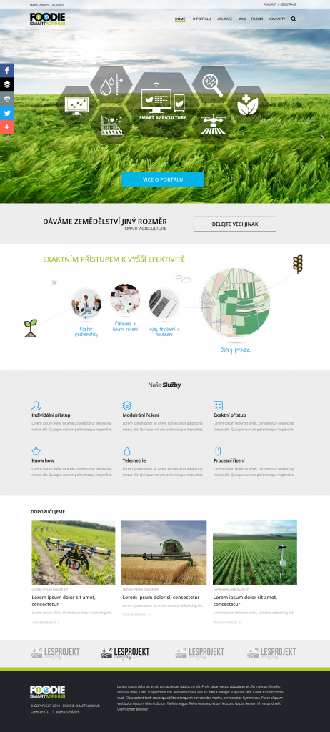
Layout
Based on wireframe - UX
Responsive template - Bootstrap
User friendly navigation
Semantic code for SEO
CTA – Call to action
http://playground.studio4u.cz/agrihub.html (raw template)

Slide 7
Technology and systems
Liferay
PostgreSQL/PostGIS
Mapserver/Geoserver
MicKa
Senslog
HS Layers NG
Virtuoso

Slide 8
Thank you for your atention

